Slide 1
IBM NAAN MUDHALVAN
SKILL UP PROJECT TITLE: ENVIRONMENTAL MONITORING COLLEGE: PERI INSTITUTE OF TECHNOLOGY DEPT: ELECTRONICS AND COMMUNICATION ENGINEERING DOMAIN: INTERNET OF THINGS (IOT) Submitted By: karpuram prathap

Slide 2
ENVIRONMENTAL MONITORING

Slide 3
What is environment ?
”Environmental” is an adjective that means concerned with the protection of the natural world
The environment is the complex of physical, chemical, and biotic factors that act upon an organism or an ecological community
Air
Land
Water

Slide 4
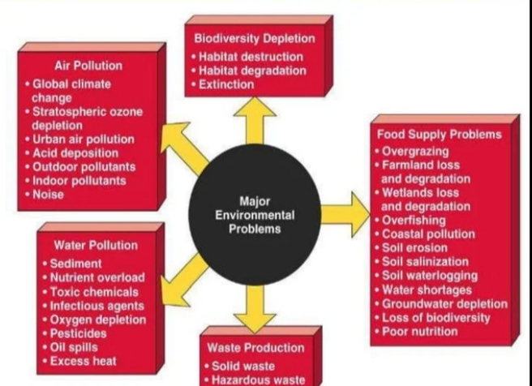
Major Environmental problem

Slide 5
ENVIRONMENTAL MONITORING
Environmental monitoring can be defined as the systematic sampling of air, water, soil, and biota in order to observe and study the environment, as well as to derive knowledge from this process.
Environmental monitoring describes the processes and activities that need to take place to characterize and monitor the quality of the environment.
Environmental monitoring is used in the preparation of environmental impact assessments, as well as in many circumstances in which human activities carry a risk of harmful effects on the natural environment

Slide 6
OBJECTIVE OF MONITORING
Monitoring of the environment may be undertaken for a number of reasons. In general monitoring is done in order to gain information about the present levels of harmful or potentially harmful pollutants in discharges to the environment, within the environment itself or in living creatures that may be affected by these pollutants. This definition can be expanded as follows:- Monitoring may be carried out to assess pollution effects on man and his environment in order to identify any possible cause and effect relationship between pollutant concentration and health effects, climatic changes etc. To evaluate pollution interactions and patterns To assess the need for legislative controls and emissions of pollutants and to ensure compliance with emission standards.

Slide 7
ENVIRONMENT MONITORING METHODS
Ground-based Sampling and Measurements Model-based Monitoring Satellite based Monitoring

